Slide 1

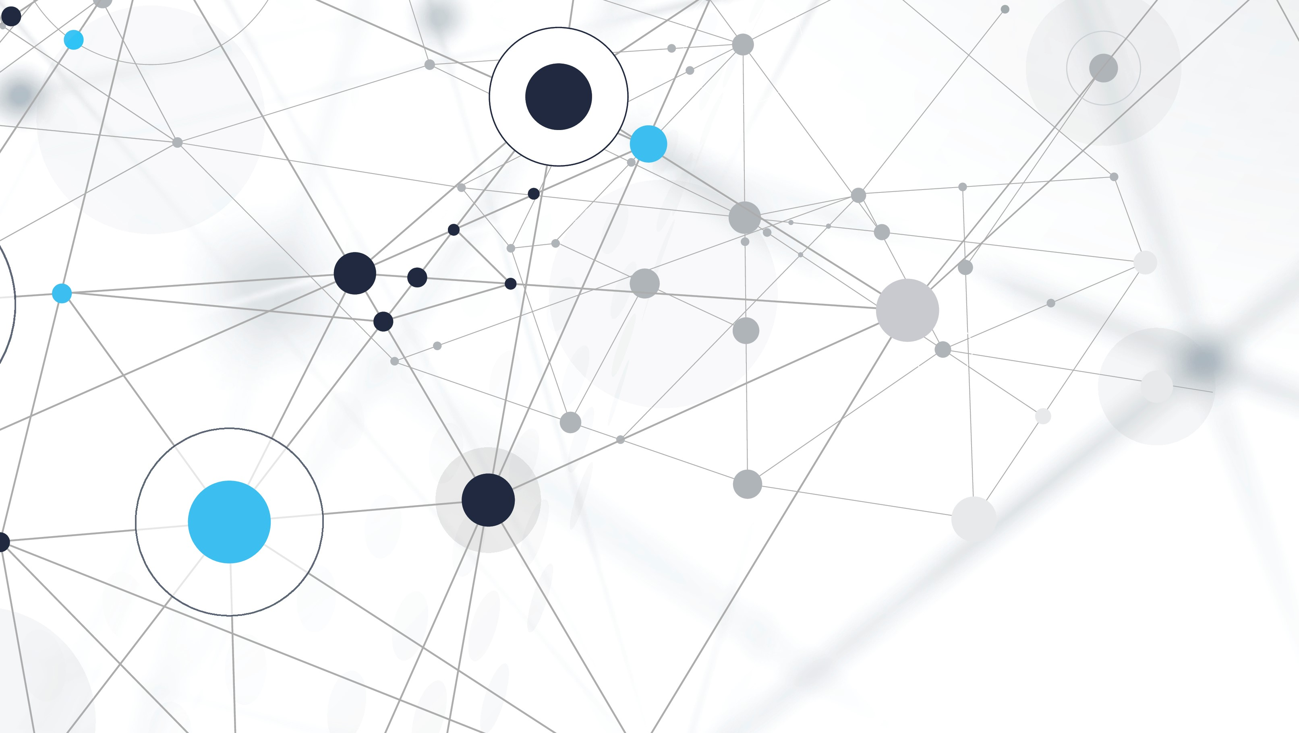
Transformer Neural Networks
TRANSFORMER MODELS
Presented by: Abdullah , PhD Candidate IT
Date: 20-06-2024
Supervision: Dr. Euijoon Ahn, Dr. Tao Huang, and Prof. Ickjai Lee
How does a transformer works?

Slide 2
Today Agenda’s
Part: 1 ISBI Paper
Part : 2 Self Attention in CV (Basic Concept)
Part: 3 Self Attention in Diffusion Model

Slide 3
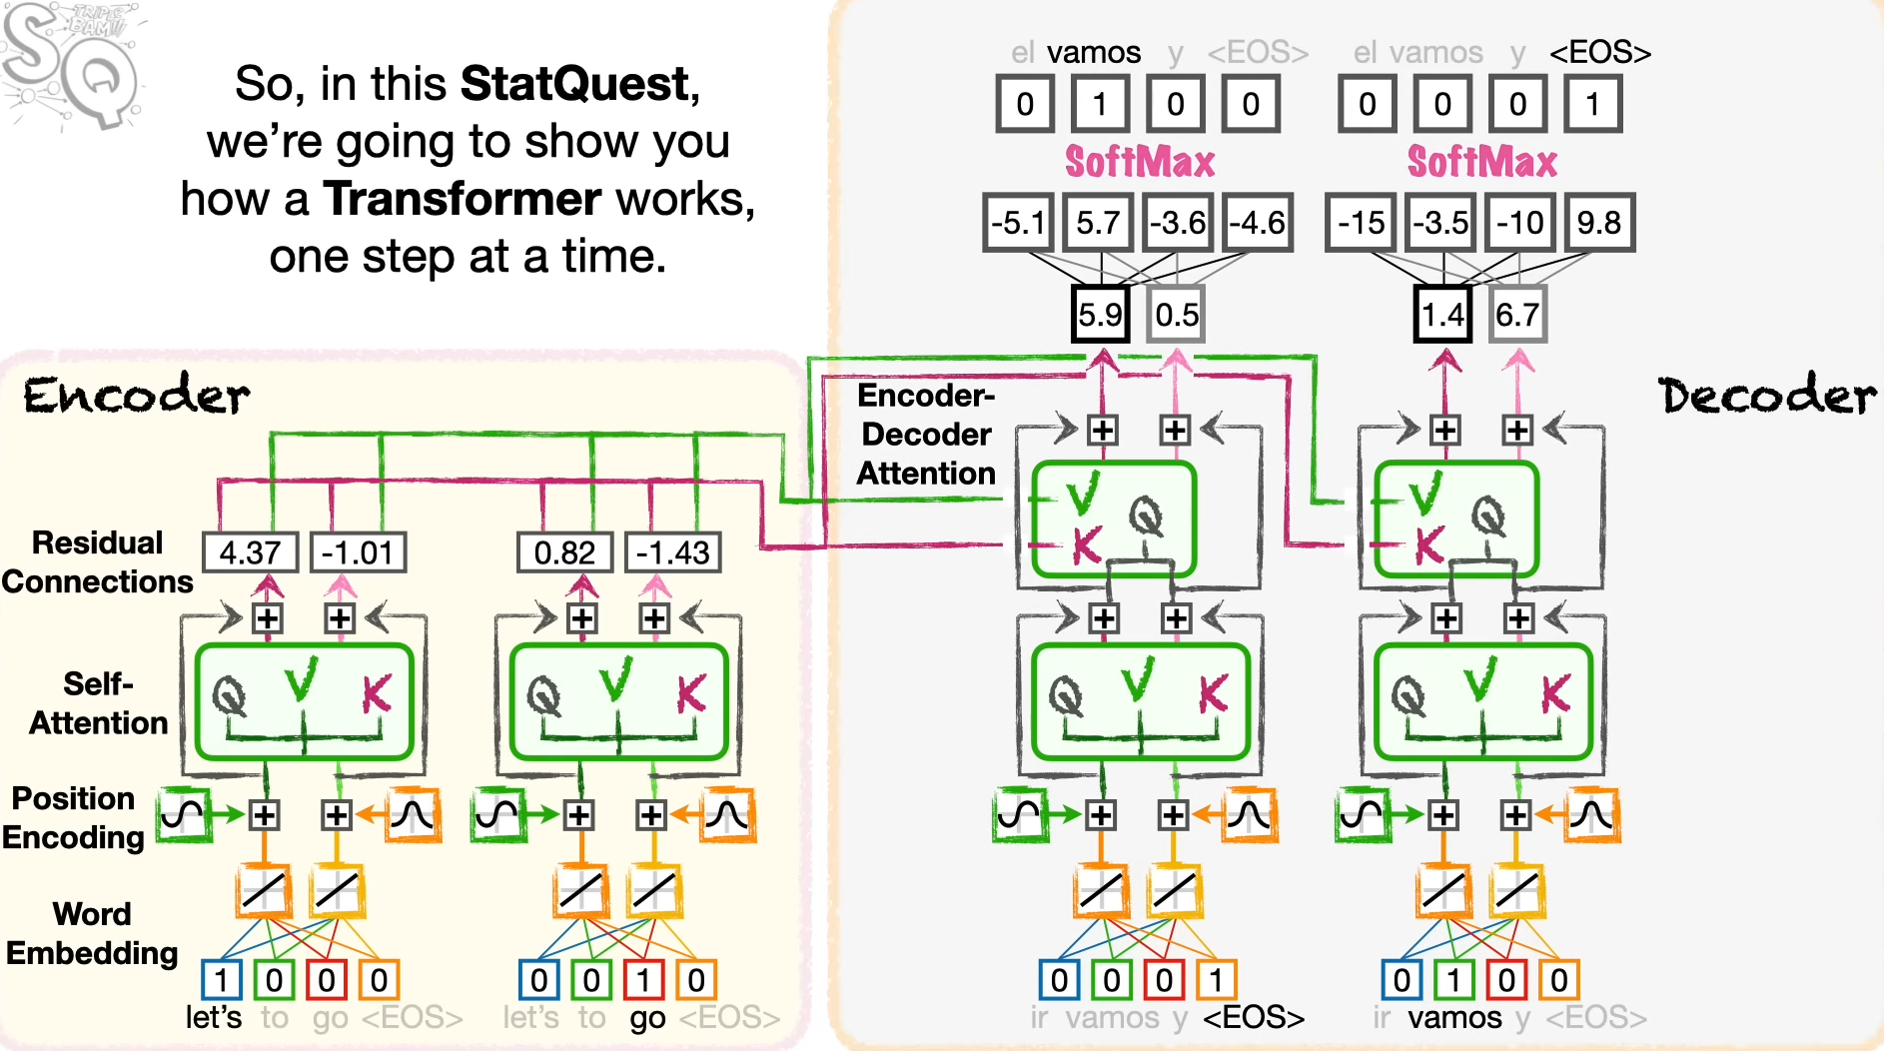
Part : 2 Self Attention in CV (Basic Transformer Concept)

Slide 4
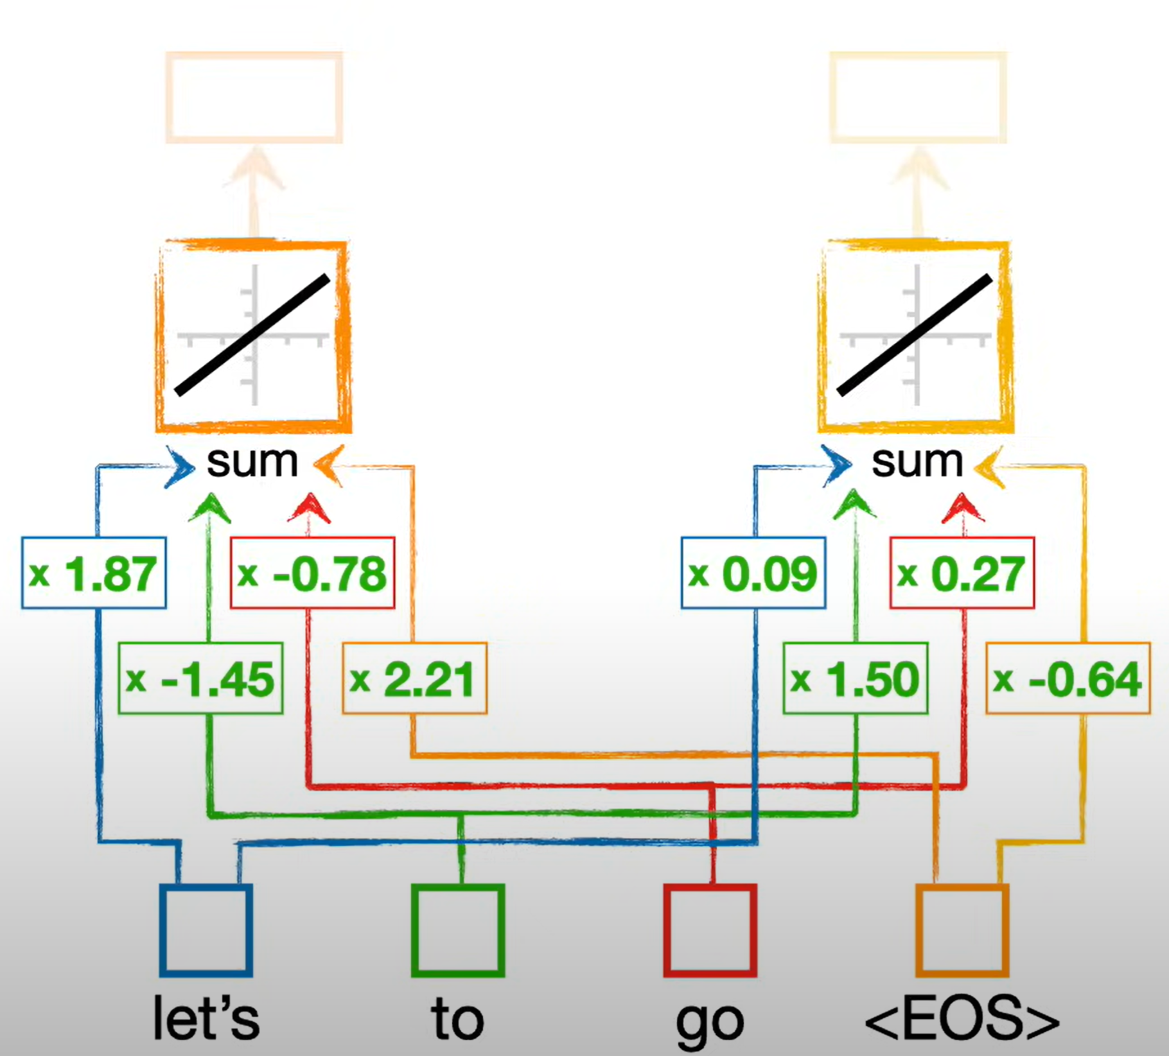
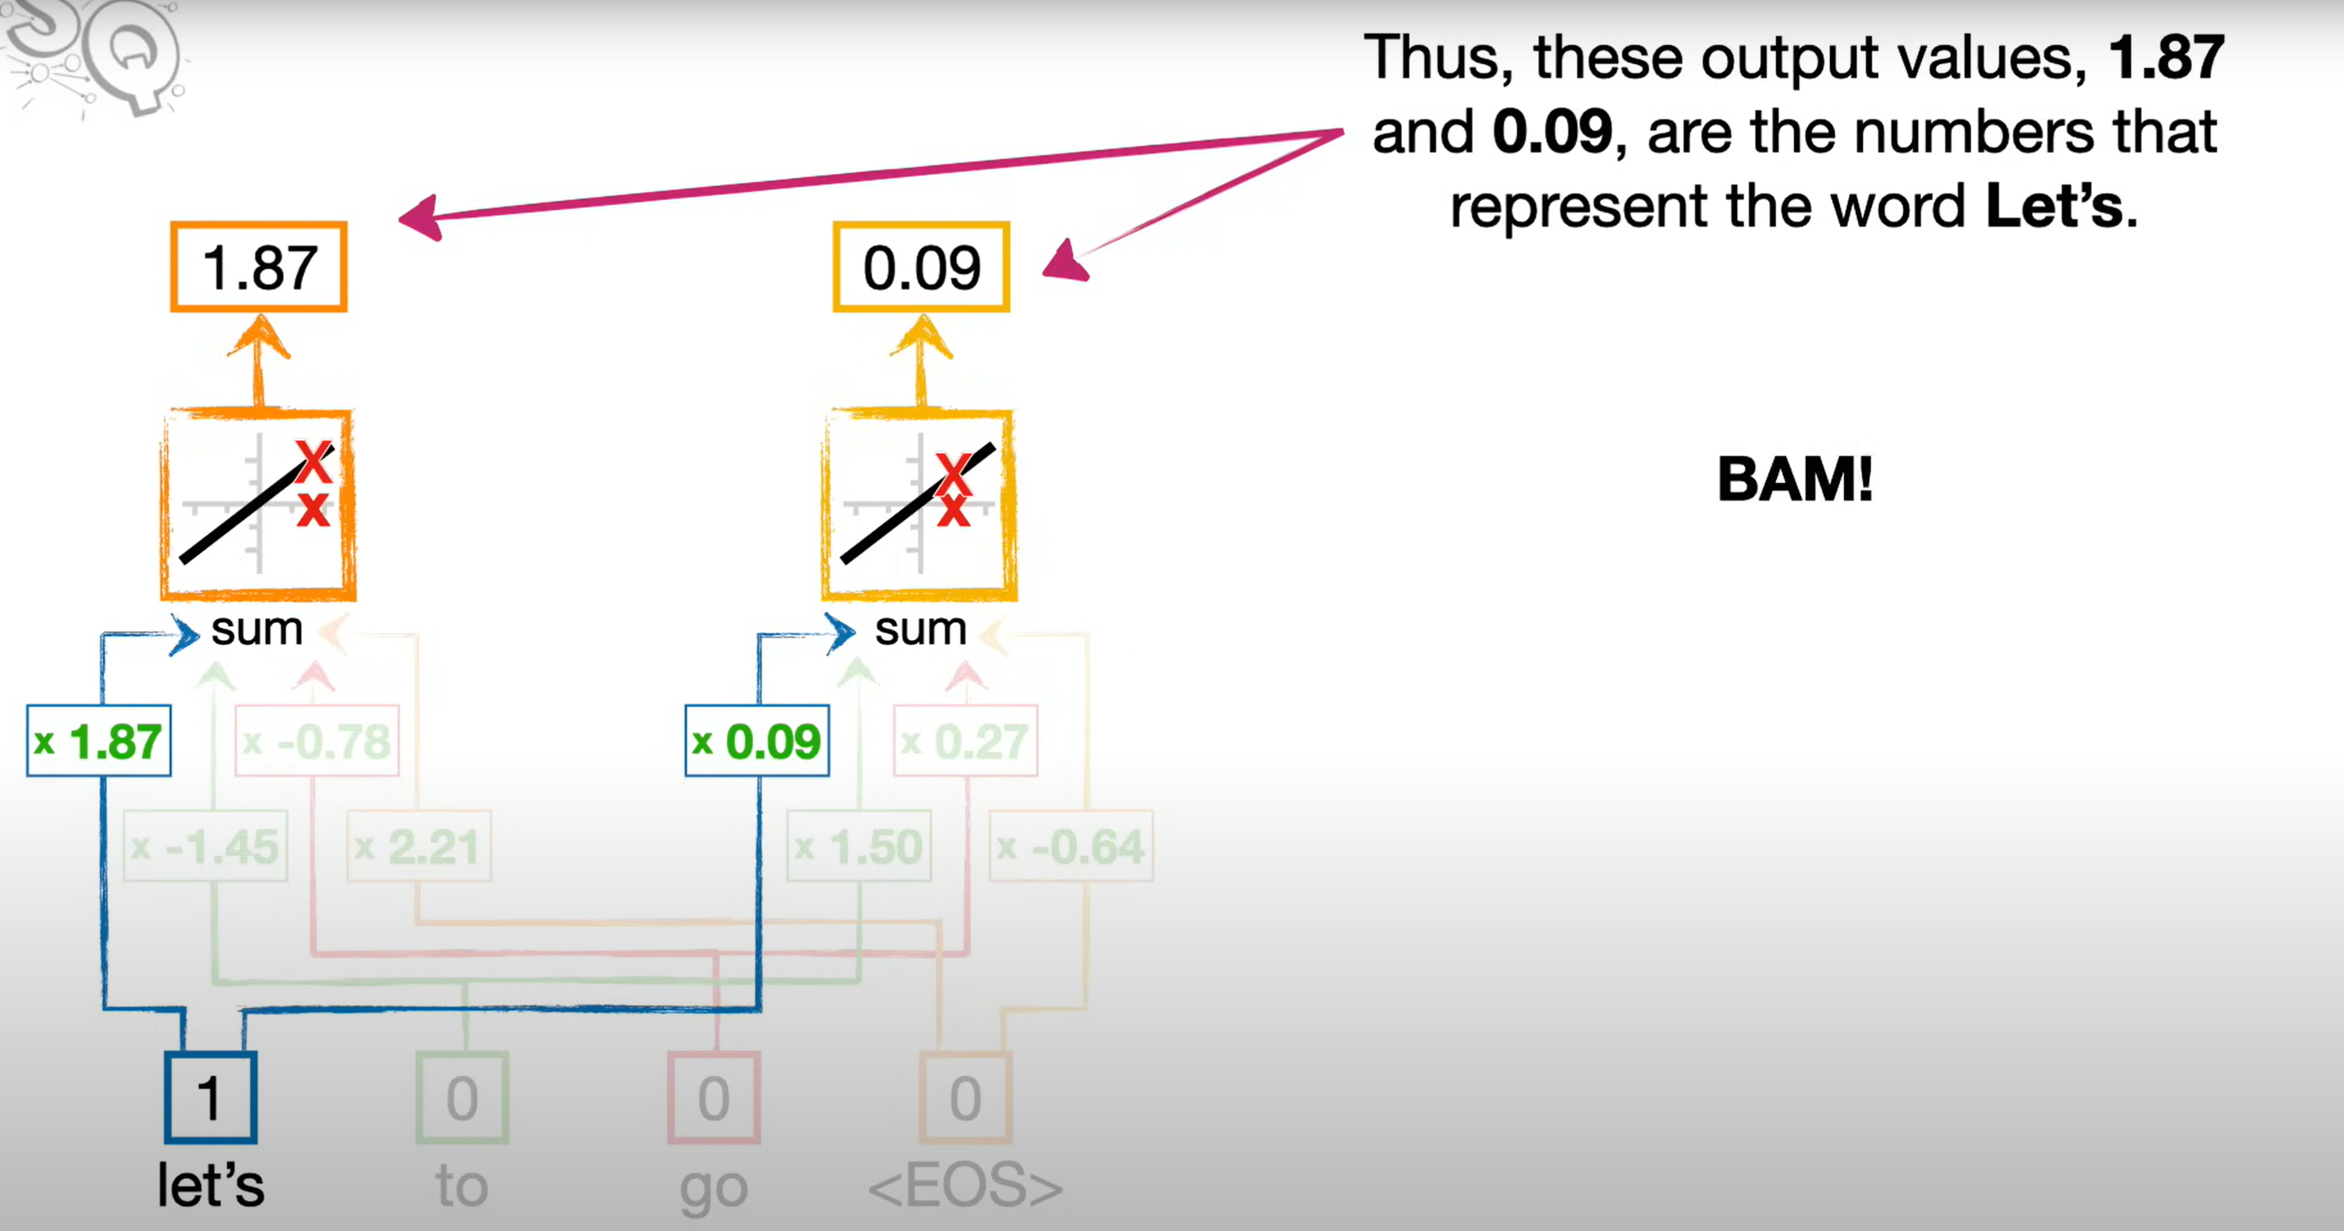
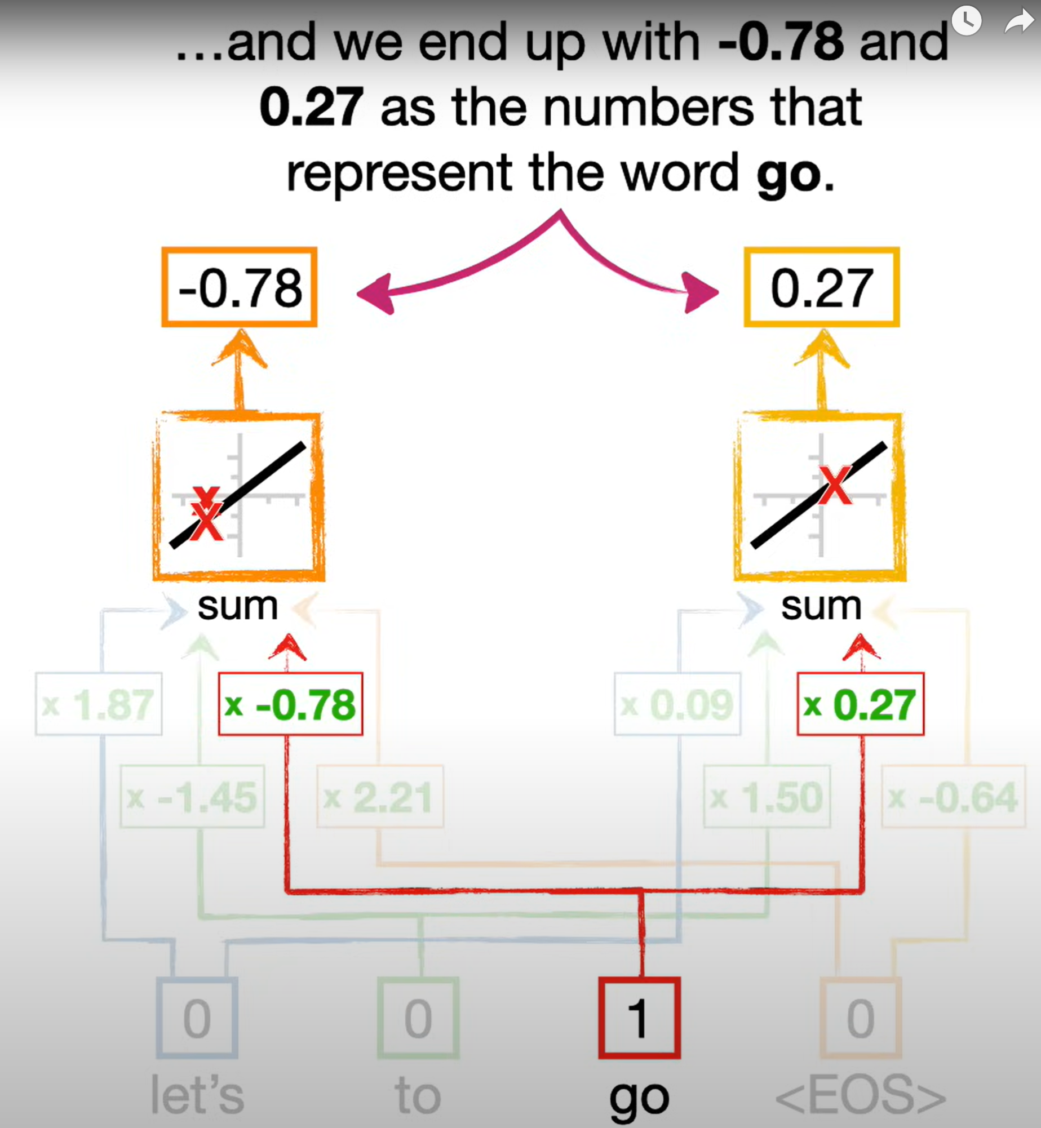
Word Embedding
Vector Representation, Semantic Similarity, Contextual Information
Pre-trained Embeddings (such as Word2Vec, GloVe, or embeddings from language models like BERT or GPT)
Activation Function
Weight
Token
End of Sequence
Notes:
There are a lot of ways to convert words into numbers, but for neural networks, one of the most commonly used methods is called Word Embedding.
In this case, we have a super simple vocabulary that allow us to input short phrases like Let’s go and to go.
Because the vocabulary can be a mix of words, word fragments and symbols. We call each input a Token.
The input are then connected to something called an Activation Function. In this example, we have 2 Activation Functions.
Each connection multiplies the input value by something called Weight.
Input embedding: Converting input tokens (words or symbols) into dense vectors that capture semantic meaning Positional encoding: Adding information about the position of tokens in the sequence to the input embeddings to help the model understand the order of words. Multi-head attention: A mechanism that allows the model to focus on different parts of the input sequence simultaneously, using multiple sets of queries, keys, and values. Output shifted right: During training, feeding the model the correct previous outputs instead of its own predictions, which helps in learning and prevents the model from seeing future information. Output embedding: The final dense vectors obtained after processing through all layers of the Transformer, representing the model's prediction or output for each token in the sequence

Slide 5
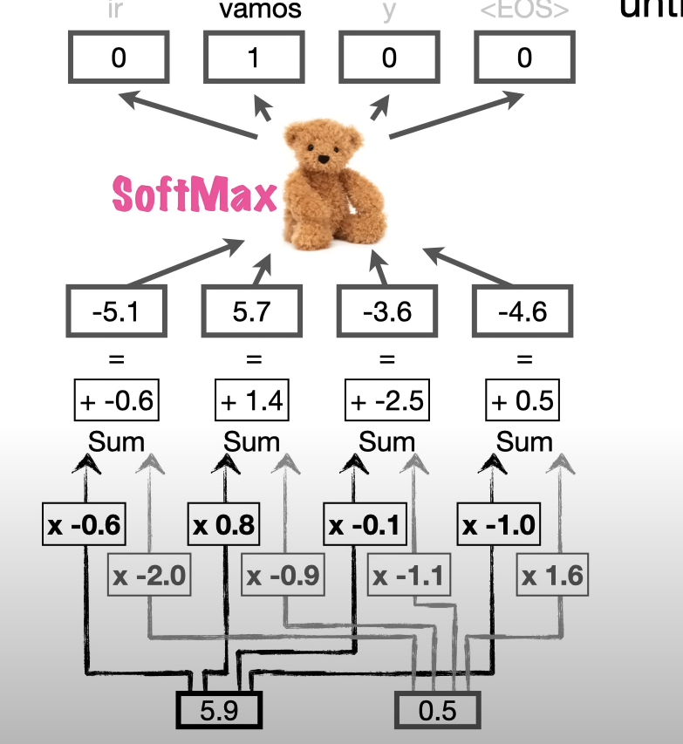

Slide 6
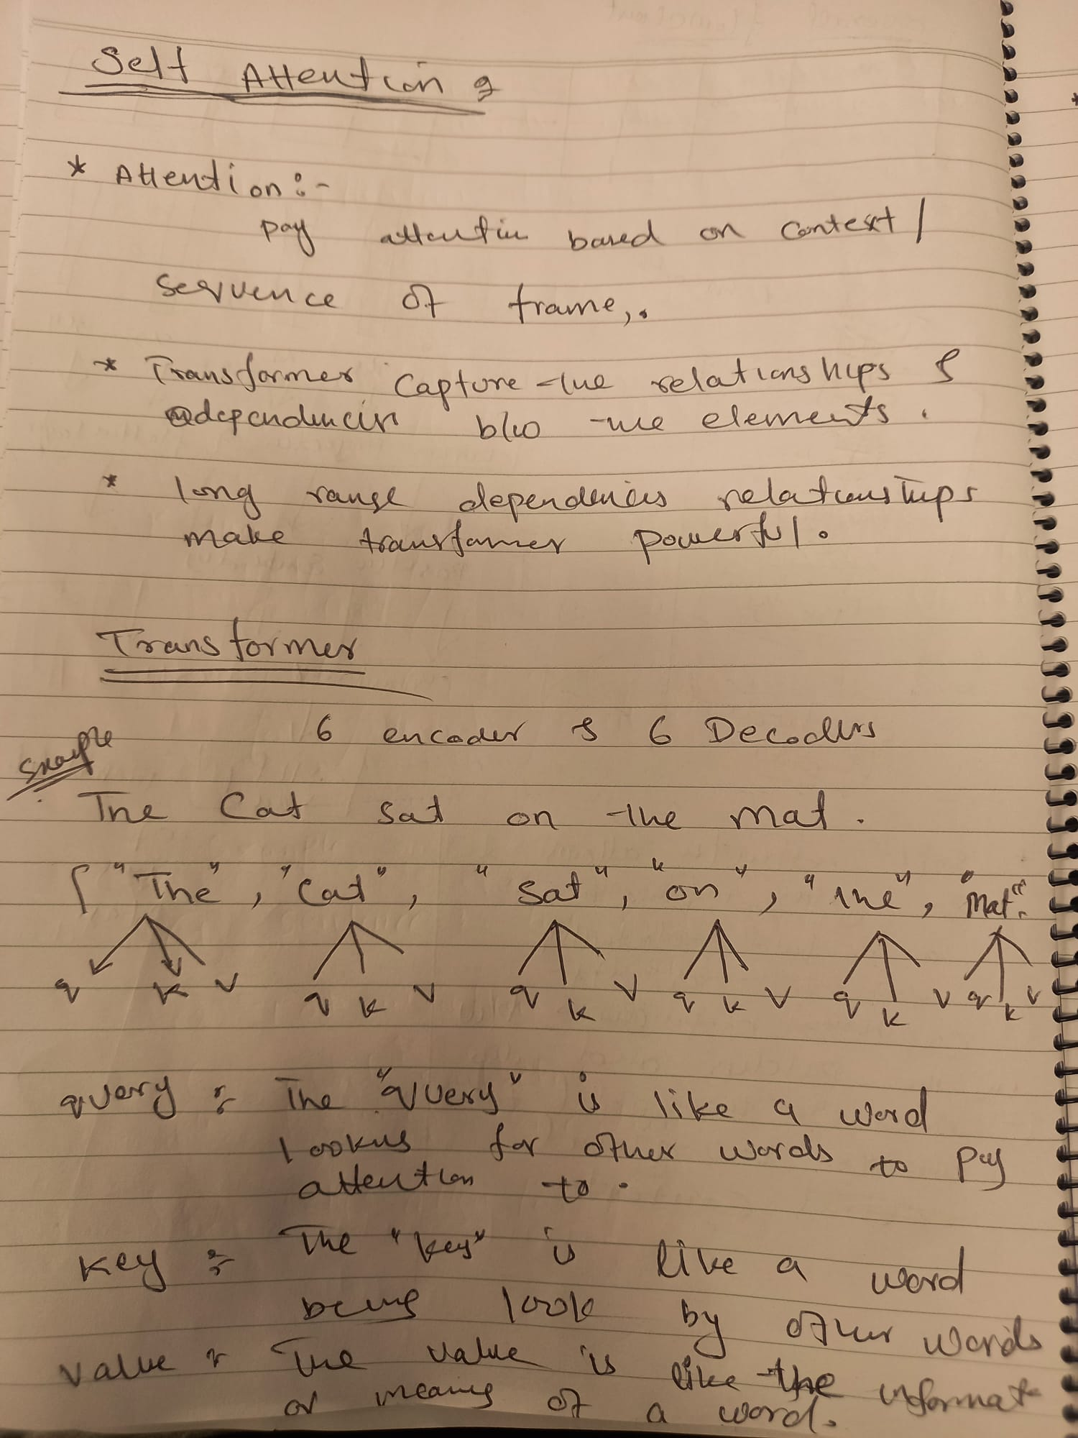
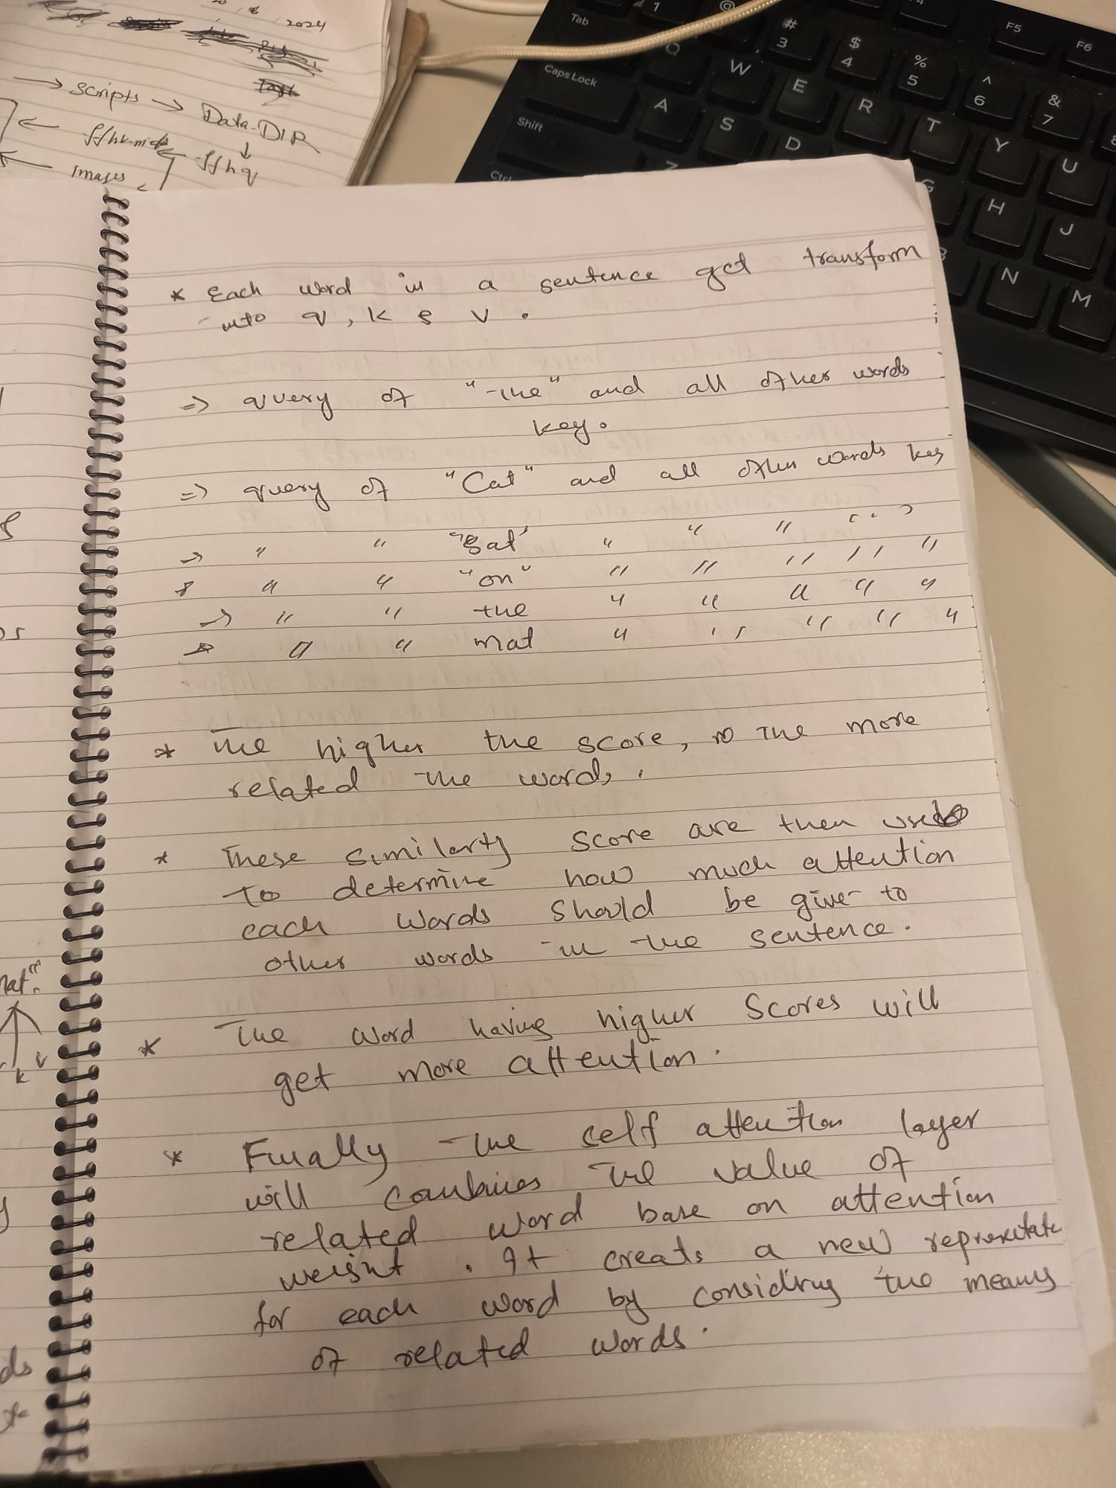

Slide 7
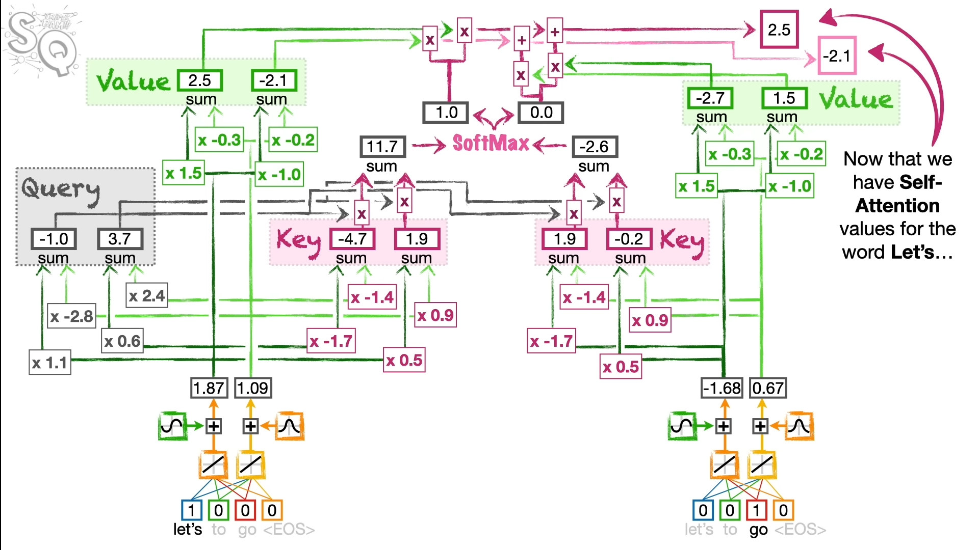

Slide 8


